Slide 1
Representing numerical data
Computers use zeros and ones exclusively – no sign, no radix point
This is not an issue for unsigned integers
But it presents problems for signed integers and real numbers
Number systems are mathematically infinite
Often applied to an infinitely complex reality
All computer representations are finite
Computers must approximate an infinite reality
The potential loss of accuracy can impact calculations
Notes:
The primary source for the material in this presentation (including figures and illustrations) is The Architecture of Computer Hardware, Systems Software, & Networking: An Information Technology Approach, 4th edition (plus supplementary materials) by Irv Englander (John Wiley & Sons, 2009).

Slide 2
Binary-coded decimal (BCD)
Uses 4-bits per decimal digit
This leaves 6 unused patterns – can be used for signs, etc.
Less space efficient, more computationally complex
Simpler to convert from text – favors I/O over calculation
Can be used with a floating decimal
Can also be used with a fixed decimal
Common for financial applications
Dec | BCD | ASCII
0 | 0000 | 00110000
1 | 0001 | 00110001
2 | 0010 | 00110010
3 | 0011 | 00110011
4 | 0100 | 00110100
5 | 0101 | 00110101
6 | 0110 | 00110110
7 | 0111 | 00110111
8 | 1000 | 00111000
9 | 1001 | 00111001
Bits | Range in BCD | Range in binary
8 | 0-99 | 0-255
16 | 0-9,999 | 0-65,535
24 | 0-999,999 | 0-16,777,215
32 | 0-99,999,999 | 0-4,294,967,295

Slide 3
Representing signed integers
Signed-magnitude representation
Easy in BCD, but inefficient
Use some of the extra 4-bit patterns as signs
Standard binary is much more efficient, but there is no sign
Could dedicate one bit to the sign, but that results in two zeros
And that complicates arithmetic algorithms
Complementary representations are commonly used instead
Taking the complement of a number involves subtracting it from a standardized basis value
The sign is a naturally occurring result of this operation
And that simplifies arithmetic algorithms

Slide 4
9’s complement
Start by picking a number of digits (word size), say 3 digits
Split the range that word size allows down the middle
The lower half of the range represents the positive values
The upper half of the range represents the negative values
Positive values simply represent themselves
0 is 0
1 is 1
289 is 289
500 doesn’t exist
All values with a first digit of 5 or higher are negative
To determine the representation of a negative value, subtract each digit from 9
–387 is 999 – 387 = 612
–499 is 999 – 499 = 500
–1 is 999 – 001 = 998
–0 is 999 – 000 = 999
–500 doesn’t exist
Utilizes the end-around carry for addition whenever the resulting value exceeds the word size
Remove the extra leftmost digit and add it to the result

Slide 5
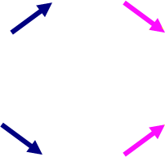
9’s complement addition
Modular addition
Circular scale
 |  |  | +250 |  |  |  |  | +250
Representation | 500 | 649 |  | 899 | 999 | 0 | 170 |  | 420 | 499
Number represented | -499 | -350 |  | -100 | -000 | 0 | 170 |  | 420 | 499
 |  |  | +250 |  |  |  |  | +250
 |  |  |  |  |  | +699
Representation | 500 | 999 | 0 | 200 | 499 |  | 500 | 899 | 999
Number represented | -499 | -000 | 0 | 200 | 499 |  | -499 | -100 | -000
 |  |  |  |  |  | -300
 |  |  |  | +300
Representation | 500 | 799 | 999 |  | 0 | 99 | 499
Number represented | -499 | -200 | -000 |  | 0 | 100 | 499
 |  |  |  | +300
799 300
1099
1
100

Slide 6
1’s complement
The binary version of 9’s complement
All values that start with a 1 are in the upper half of the range and therefore negative
1’s complement representation involves inversion
To invert a binary value, take the value and change all ones to zeros and all zeros to ones
Note that we still have two representations of 0 – all ones and all zeros
Arithmetic algorithms are identical to 9’s complement
Note that we cannot convert directly between 9’s complement and 1’s complement
So we convert to signed-magnitude form as an intermediary
Numbers | Negative |  | Positive
Representation method | Complement |  | Number itself
Range of decimal numbers | -127₁₀ | -0₁₀ | +0₁₀ | 127₁₀
Calculation | Inversion |  | None
Representation example | 10000000 | 11111111 | 00000000 | 01111111

Slide 7
10’s complement
Shift the negative portion of the range right by 1
Gives us only one representation of 0
Results in slightly different size positive and negative ranges
All values starting with a 5 or higher are still negative
Positive values represent themselves
Subtract a negative value’s magnitude from 10^{n}, where n is the word size
Can also simply add 1 to its 9’s complement representation
When adding, simply discard any extra digit
Numbers | Negative |  | Positive
Representation method | Complement |  | Number itself
Range of decimal numbers | -500 | -001 | 0 | 499
Calculation | 1000 minus number |  | none
Representation example | 500 | 999 | 0 | 499

Slide 8
2’s complement
Like 10’s complement, but in binary
Has only one representation of 0
Has slightly different size positive and negative ranges
All values starting with a 1 are negative
Positive values represent themselves
To represent a negative value, subtract its magnitude from 2^{n}, where n is the word size
If n = 8, subtract from 1 0000 0000 (which is 1 followed by n 0s)
Or add 1 to its 1’s complement representation
No end-around carry – when adding, simply discard any extra digit
More commonly used than 1’s complement
Numbers | Negative |  | Positive
Representation method | Complement |  | Number itself
Range of decimal numbers | -128₁₀ | -1₁₀ | 0 | 127₁₀
Calculation | 1 0000 0000 minus number |  | none
Representation example | 1000 0000 | 1111 1111 | 0000 0000 | 0111 1111

Slide 9
2’s complement arithmetic
Standard binary arithmetic
Discard any final carry
Subtraction is simply adding a negative
 | 7 |  |  | 00000111
+ | –9 |  | + | 11110111
 | –2 |  |  | 11111110
 | –7 |  |  | 11111001
+ | –9 |  | + | 11110111
 | –16 |  |  | (1)11110000
 | –7 |  |  | 11111001
– | 9 |  | + | 11110111
 | –16 |  |  | (1)11110000
 | 7 |  |  | 00000111
– | 9 |  | + | 11110111
 | –2 |  |  | 11111110

Slide 10
Exponential notation
Equivalent representations of 8974
8974 x 10⁰
897.4 x 10¹
89.74 x 10²
8.974 x 10³
0.8974 x 10⁴
0.08974 x 10⁵
0.008974 x 10⁶
8974 x 10⁰
89740 x 10⁻¹
897400 x 10⁻²
8974000 x 10⁻³
89740000 x 10⁻⁴
Sign of the mantissa |  | Sign of the exponent
 | -0.35790 x 10⁻⁶
Location of radix point | Mantissa (Significand) |  | Base | Exponent

Slide 11
Floating point format
Standardized formats are generally used
Some digits are used for the exponent, the rest for the mantissa/significand
A larger exponent means a greater range of values
A larger mantissa/significand means greater precision of values
May be represented in signed-magnitude, complementary or excess-N notation
The base of the exponent and the position of the radix point are implicit
Sign of the mantissa
SEEMMMMM
2-digit Exponent | 5-digit Mantissa/Significand

Slide 12
A sample floating point format
8 decimal digits
1st digit is for the sign of the mantissa/significand
0 for positive, 5 for negative
Next 2 digits are for the exponent
Excess-50 notation
Remaining 5 digits are for the mantissa/significand
The base of both the mantissa/significand and the exponent is 10
The decimal point is implicit at beginning of the mantissa/significand
0.0 is a special case consisting of eight zeros
05234934 = 0.34934 x 10² = 34.934
54778364 = –0.78364 x 10⁻³ = –0.00078364
55584542 = –0.84542 x 10⁵ = –84542
05031415 = 0.31415 x 10⁰ = 0.31415

Slide 13
Formatting floating point values
Five step algorithm
If there’s no exponent, provide one of 0
Increase the exponent as needed to shift the radix point to the left of all non-zero digits
Decrease the exponent as needed to shift the radix point so there are no leading zeros to the right of it
Leading zeros just cut into precision
Normalization
Adjust the precision by adding zeros or rounding off to the correct number of digits in the mantissa/significand
Store the exponent, mantissa/significand, and sign into the desired floating point format
72.0369 = 72.0369 x 10⁰ = 0.720369 x 10² → 05272037
-349 x 10⁻² = -0.349 x 10¹ = -0.34900 x 10¹ → 55134900
0.00015 = 0.00015 x 10⁰ = 0.15000 x 10⁻³ → 04715000

Slide 14
Adding floating point values
Treat the parts separately
The radix points must line up
Shift the digits in the value with the smaller exponent to the right by increasing that exponent to match the larger one
It’s fine to work with exponents in excess-N notation
Once the exponents are equal, add the mantissas/significands
If overflow occurs, shift the mantissa/significand to the right to make room for it by increasing the exponent by 1
Round the result to fit the allocated mantissa/significand size
Don’t neglect the signs!
Subtraction is just adding a negative
 | 05299936 | → | 05299936
+ | 04979860 |  | 05200079860
 |  |  | (1)00015860 | → | 05310001(5860) | → | 05310002

Slide 15
Multiplying floating point values
Alignment of the radix points is not necessary
Multiply (or divide) the mantissas/significands
Keep track of the signs
Add (or subtract) the exponents
When adding exponents in excess-N notation, you must subtract N out of the result
When subtracting exponents in excess-N notation, you must add N into the result
Normalize, and then round as necessary
 | 05213942 | → | 0.13942 |  | 52 + 51 = 103 – 50 = 53
x | 05120340 |  | 0.20340 |  | 53 – 1 = 52 (normalize)
 |  |  | 0.028358028 | → | 05228358(028) | → | 05228358

Slide 16
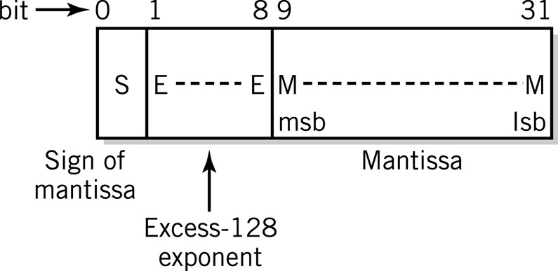
Floating point in binary form
Same mechanisms and techniques apply
Sample 32-bit format
Has an approximate range from 10⁻³⁸ to 10³⁸
One bit is used for the sign of the mantissa/significand
0 for positive, 1 for negative
Eight bits are used for the exponent
Excess-128 (base 2)
The twenty-three remaining bits are used for the mantissa/significand
After normalization, the first bit will always be 1, so there’s no need to store that first bit
Effectively gives us a 24-bit mantissa/significand (about 7 decimal digits)
0.0 is treated as a special case

Slide 17
Floating point standards
IEEE 754 – 32-bit and 64-bit
IEEE Computer Society
Supported in most modern hardware
32-bit float – approximately 7 decimal digits of precision
One bit is used for the sign of the mantissa/significand (0 for positive, 1 for negative)
Eight bits are used for the base 2 exponent in excess-127
The exponents of 0 and 255 are special cases
Twenty-three bits are used for the mantissa/significand normalized to 1.MMMMM… format
Initial 1-bit is implicit rather than stored
Special cases include 0, very small non-normalized values, and infinity
64-bit float – approximately 15 decimal digits of precision
One bit is used for the sign of the mantissa/significand
Eleven bits are used for the base 2 exponent in excess-1023
The exponents of 0 and 2047 are special cases
Fifty-two bits are used for the mantissa/significand normalized to 1.MMMMM… format
Exponent | Mantissa | Value
0 | ±0 | 0
0 | Not 0 | ±2⁻¹²⁶ x 0.M
1-254 | Any | ±2⁻¹²⁷ x 1.M
255 | ±0 | ±∞
255 | not 0 | special condition (NaN)

Slide 18
Performance considerations
Integers
Operations are easier for the computer
Storage efficient – various sizes
Potential for greater precision and accuracy
Fast
Floating point
Allow for a fractional part
Wide range of values
Select smallest size sufficient for task
BCD
Useful for non-integer values when accuracy outweighs performance

Slide 19
The importance of data
Storing and processing data is all computers do
All data is ultimately binary
Multimedia, to the user’s perspective
Numbers, text, images, sounds, videos, etc.
All data originates in the computer system’s environment
Brought in via an interface (keyboard, microphone, scanner, etc.) and converted to binary form
Environment is continuous and infinite (analog)
Computer system is discrete and finite (digital)
Often impossible to represent the true reality of the environment
Typically settle for approximations of that reality
Notes:
The primary source for the material in this presentation (including figures and illustrations) is The Architecture of Computer Hardware, Systems Software, & Networking: An Information Technology Approach, 4th edition (plus supplementary materials) by Irv Englander (John Wiley & Sons, 2009).

Slide 20
Considering data formats
Many different ways to represent data
Methods vary with complexity of original and type of processing intended
Some methods intended to be transient, others more permanent
Some methods meant for local use, others for transmission
Some provide closer approximations to original
Require more storage
Data compression can reduce storage requirements
Once in binary form, data can be stored indefinitely and transmitted repeatedly
Metadata is often added to enhance compatibility
Each program is free to decide how best to represent its data
Open formats
Proprietary formats
Import and export

Slide 21
Alphanumeric character data
Text – letters, digits, punctuation, special characters, control characters
Each character gets mapped to a unique pattern of bits
Many such mappings are possible
Choice is arbitrary as long as writer and reader agree
Standardized mappings/encodings (character sets) are preferable
ASCII – 7-bit (128 chars) – ANSI
Latin-1 Extended ASCII – 8-bit (256 chars) – ISO
EBCDIC – 8-bit (256 chars) – IBM
Unicode – 16-bit (65,536 chars) – Unicode Consortium
Sources of textual input
Keyboard, OCR, bar code reader, magnetic stripe reader, RFID reader, natural language software

Slide 22
ASCII
MSD LSD | 0 | 1 | 2 | 3 | 4 | 5 | 6 | 7
0 | NUL | DLE | SP | 0 | @ | P | ‘ | p
1 | SOH | DC1 | ! | 1 | A | Q | a | W
2 | STX | DC2 | “ | 2 | B | R | b | r
3 | ETX | DC3 | # | 3 | C | S | c | s
4 | EOT | DC4 | $ | 4 | D | T | d | t
5 | ENQ | NAK | % | 5 | E | U | e | u
6 | ACJ | SYN | & | 6 | F | V | f | v
7 | BEL | ETB | ‘ | 7 | G | W | g | w
8 | BS | CAN | ( | 8 | H | X | h | x
9 | HT | EM | ) | 9 | I | Y | i | y
A | LF | SUB | * | : | J | Z | j | z
B | VT | ESC | + | ; | K | [ | k | {
C | FF | FS | , | < | L | \ | l | |
D | CR | GS | - | = | M | ] | m | }
E | SO | RS | . | > | N | ^ | n | ~
F | SI | US | / | ? | O | _ | o | DEL
74₁₆
111 0100
Collating sequence – uppercase vs. lowercase – digits
Printing characters vs. control characters

Slide 23
Collating Sequence
Ordering of Characters
Specifically designed for ordering

Slide 24
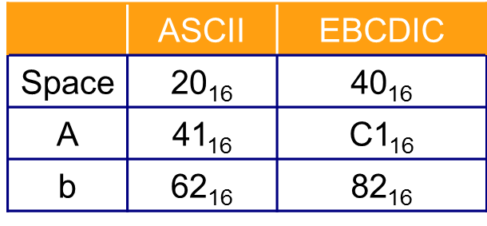
Other character sets
Latin-1 Extended ASCII
http://msdn.microsoft.com/en-us/library/ms537495(VS.85).aspx
Unicode
http://unicode.org/charts/
EBCDIC
http://en.wikipedia.org/wiki/Extended_Binary_Coded_Decimal_Interchange_Code#Codepage_layout

Slide 25
Image data
Many image formats exist
Divisible into two broad categories
Bitmap/raster image
Collection of pixels
Paint programs and photo editors
JPEG, GIF, PNG, BMP, TIFF, etc.
Vector/object image
Collection of geometrically defined objects
Draw programs
SVG, Flash, PostScript, etc.

Slide 26
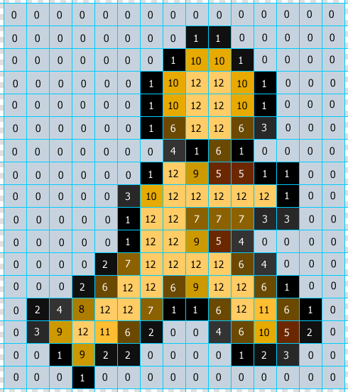
Bitmap images
Superimpose grid over image
Each square is a picture element (pixel)
Record characteristics of each pixel in numeric form
Color, color intensity, transparency, etc.
Include metadata to clarify interpretation
Store pixel data row by row from top to bottom
Each pixel’s data could require 1 bit to many bytes
Storage adds up quickly
Approximation of original
Each pixel must be only one color
More pixels, more detail, more storage
Resolution
Useful for highly detailed images and those that require whole-image processing

Slide 27
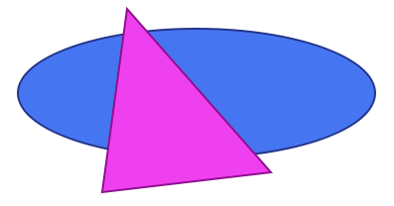
Object images
Geometric primitives
Shapes, lines, curves, etc.
Mathematically defined
Varied through parameters
Easily transformed
Representable as text
Require much less storage
Pixels determined at display time
Easier to manipulate component parts
Each maintains its own identity
Most output devices are raster devices
Must be rasterized prior to display
Trade storage savings for more processing
<?xml version="1.0" standalone="no"?>
<!DOCTYPE svg PUBLIC "-//W3C//DTD SVG 1.1//EN"
"http://www.w3.org/Graphics/SVG/1.1/DTD/svg11.dtd">
<svg width="100%" height="100%" version="1.1"
xmlns="http://www.w3.org/2000/svg">
<ellipse cx="250" cy="160" rx="180" ry="65"
style="fill:#4675F2; stroke:#233589; stroke-width:2" />
<polygon points="180,75 325,240 155,260"
style="fill:#EF40F0; stroke:#901090; stroke-width:2" />
</svg>

Slide 28
Data compression
Reorganizing data so it requires less storage and bandwidth
Compression ratio = compressed size/original size
0 to 1 – smaller values indicate better compression
Compression protocols
Lossless vs. lossy
Keyword encoding
Mappings
Tradeoffs
More processing typically required
Point of diminishing returns

Slide 29
Huffman encoding
Text compression protocol using variable length bit patterns
Short patterns for common characters
Requires unambiguous patterns
No single, standardized mapping of Huffman codes
Freq
Code
Freq
Code
E
12.32
100
G
2.77
10101
T
8.37
111
P
2.58
10110
A
8.23
0000
U
2.43
10111
I
8.08
0001
F
2.28
11001
S
7.64
0011
Y
1.46
010101
O
7.59
0100
B
1.26
110000
N
6.81
0110
W
1.07
0101000
R
6.67
0111
V
0.97
0101001
C
4.04
1101
K
0.43
1100011
H
3.94
00100
X
0.29
11000101
L
3.79
00101
J
0.14
110001001
D
3.40
01011
Q
0.14
1100010000
M
3.06
10100
Z
0.09
1100010001

Slide 30
Run-length encoding
Relies on repeating patterns
Each replaced by escape code, single pattern and count
Lossless
Easily decompressed
Well-suited to images – used in GIF
64 x 64 = 4,096 bytes
BMP = 5,174 bytes
GIF = 153 bytes
64 x 64 = 4,096 bytes
BMP = 5,174 bytes
GIF = 343 bytes

Slide 31
Video images
Series of still images (frames) shown in sequence
Bitmap images most common
Multiplies storage requirements by frame rate
Results in tremendous storage requirements
Various optimization techniques
Reduce frame dimensions
Limit colors
Reduce frame rate
Spatial compression
Temporal compression
Streaming

Slide 32
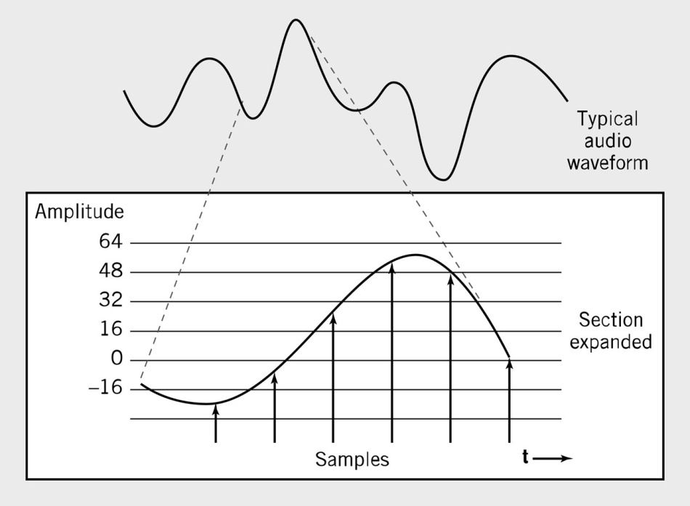
Audio data
Sound consists of smooth, continuous waves
Infinite variability between any two points
Must be represented numerically in computer
Numerical representations are discrete and finite
Sampling determines amplitude of original wave at regular intervals
Records those amplitudes as numeric values
Often supplemented with metadata
Sequence can be used to reconstruct approximation of original wave
Higher sampling rates produce closer approximations, but more numbers means more storage
Common sampling rate is 44,100 Hz (samples per second)

Slide 33
Internal data formats
Everything stored as bits internally
Contents of storage consist of a huge series of bits
Any given segment of that series could represent nearly anything
Data types used internally to define meaning for groups of bits
Atomic/Primitive – Boolean, character, enumerated, integer, float, etc.
Composite – array, object, string, structure, etc.

