Slide 1
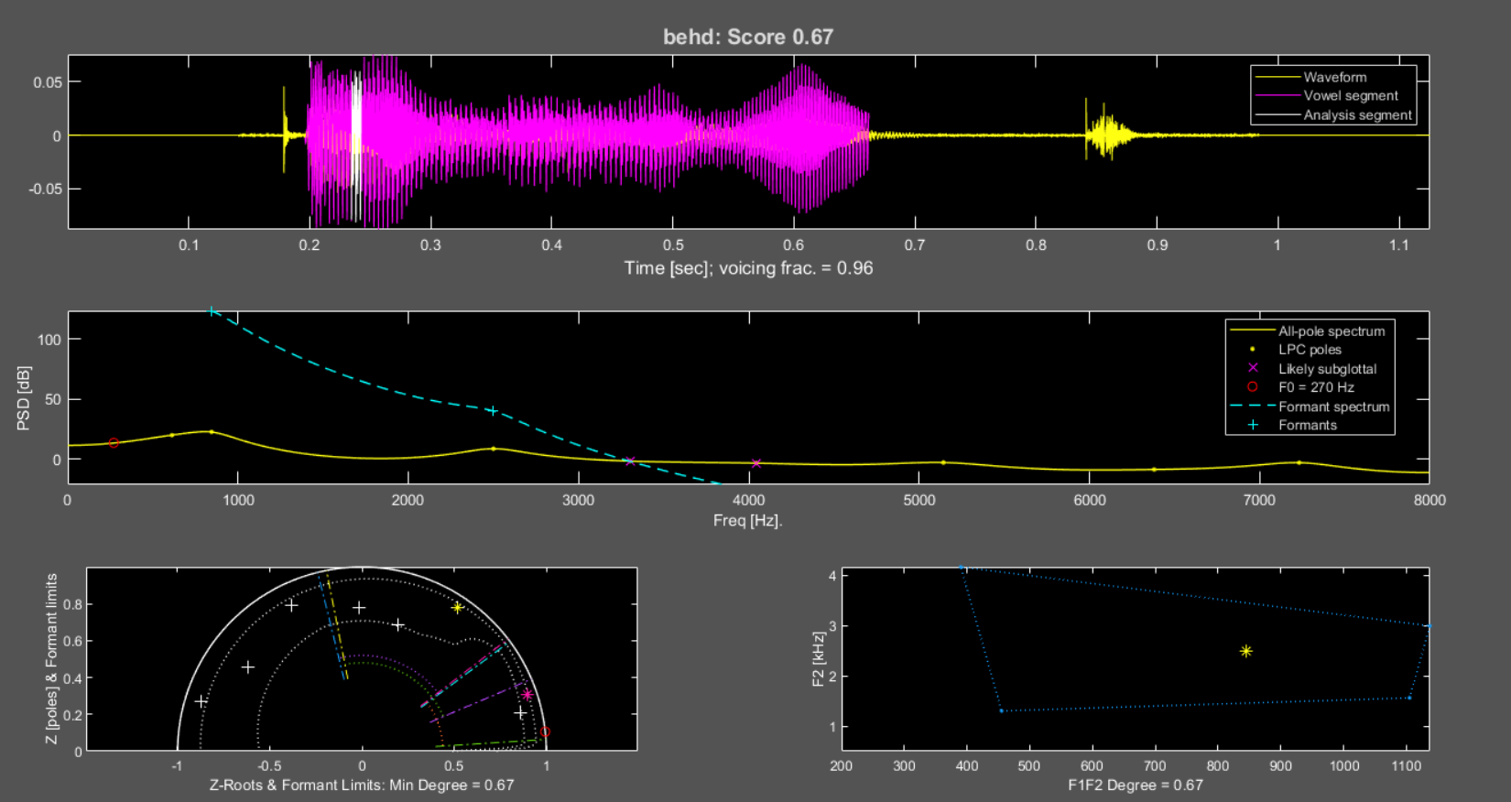
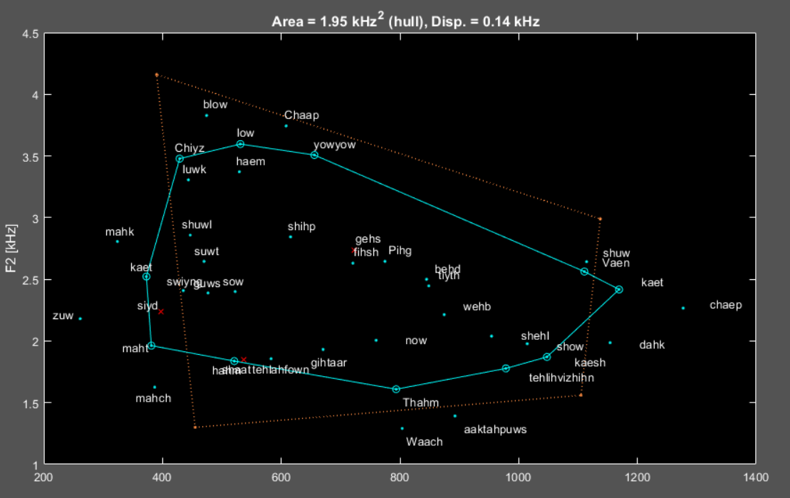
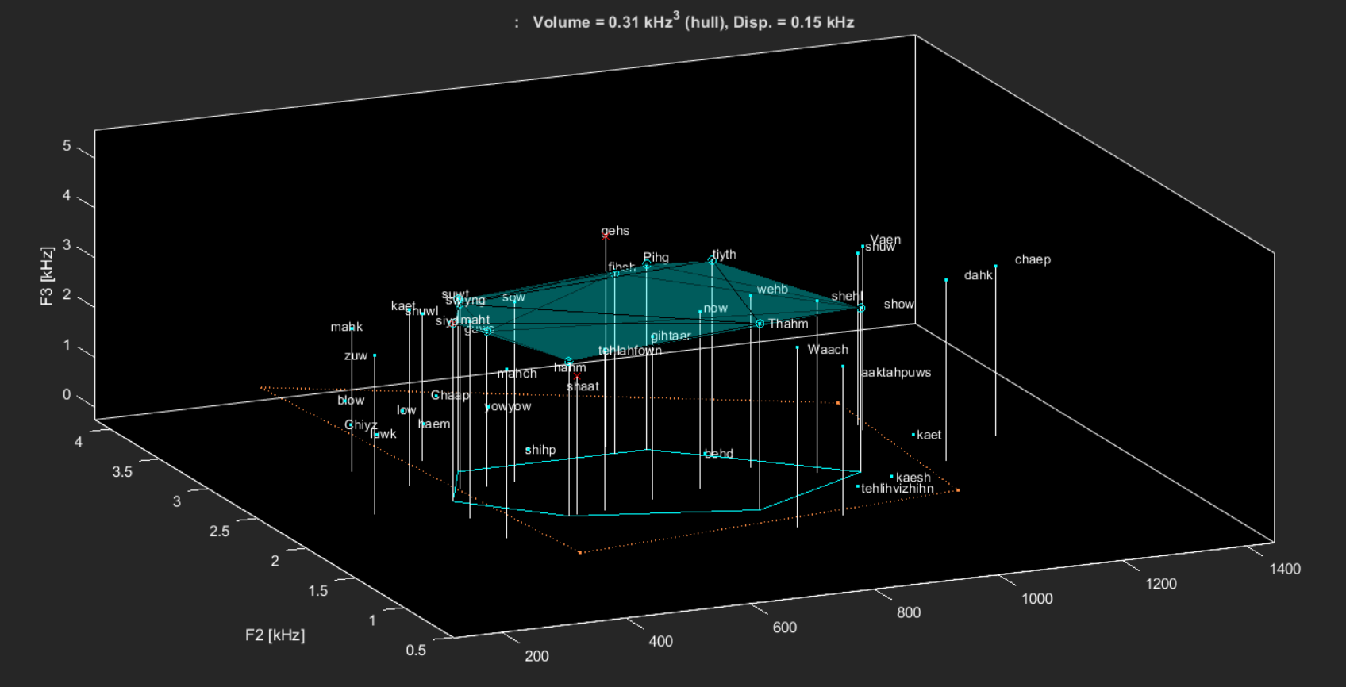
Automated Vowel Space Measurement of Young Children
Marisha Speights Atkins, PhD¹, Maame Agyarko, BS^{1,2}, Joel MacAuslan, PhD³
¹Northwestern University, ²University of Illinois Urbana Champaign, ³Speech Technologies & Applied Research Corp.
Background
Results: Linear Predictive Coding (LPC) Model for One Sample
Results
Nearly 70 years ago, Peterson and Barney (1952) published their article on vowel formant patterns in men, women, and children.
55 years after this seminal work, Vorperian and Kent (2007) identified 14 studies reporting data on mean vowel formant frequencies, but mostly not variability. Of these, 6 included children ages 3-5 years.
Following this time, only a few studies have focused on patterns of vowel acquisition and variability in production in this age group ( e.g., McGowan et al., 2014, Kent & Vorperian, 2018, Roepke & Brosseau-Lapré, 2021).
Investigation measuring vowel production broadly in the preschool age population is needed to best understand the range of formant values that typically occur during the early years of speech development and the nature of deviations present in disordered speech that affect intelligibility.
The time, training, and labor-intensive nature of measuring F1/F2 values by hand impedes the ability for larger scale studies.
More recently, advanced computational approaches have enabled more efficient data analysis making it possible to investigate larger and more diverse groups of young children.
Top: Waveform, SpeechMark syllabic segment, and small window about vowel-LM within segment.
Mid: LPC spectrum and poles (solid, .) ; F0 (red circle); formant spectrum and identified formants (dashed, +); likely subglottal resonances (x).
LL: Z-plane of unit circle (solid); positions of poles (+); formants and frequency boundaries (color); bandwidth boundaries (dotted).
LR: Location of identified (F1,F2) (*); fiducial boundaries of a conventional (F1,F2) quadrilateral (dotted).
RQ: Is there a difference between hand and automated measurement of the mean F1 & F2 values?
t-Test statistics were not significant at alpha .05 when comparing F1 Hand and SM measurements for:
/i/, /ɪ/, /ɛ/, /æ/, /u/, /o/, /ʌ/
t-Test statistics were not significant at alpha .05 when comparing F2 Hand and SM measurements for:
Results: Vowel Space Area Modeling for Multiple Samples
/ɪ/, /ɛ/, /æ/, /u/, /ʌ/, /ɑ/
Each point is labeled with the DARPAbet spelling of the presented stimulus item. Low-confidence points are shown in red.
The reported area 1.95 kHz² is the area of the convex hull after removing the most extreme points and rescaling to construct a robust, consistent estimator.
The dispersion 0.14 kHz is the RMS dis-tance from the average point to the cen-troid of all the points after exclusion of the extremes and rescaling.
LPC poles are identified as oral (form-ants) or subglottal based on individual frequency and bandwidth, on joint mem-bership in quadrilaterals (F1/F2 and F1/F3, per Vorperian & Kent, 2007), and on oral/subglottal competition.
Subglottal formant and bandwidth param-eters are taken from Stevens (1998), Lulich (2010), Lulich et al. (2011), aug-mented with frequency estimation from published tracheal dimensions (Propst et al., 2021; Griscom & Wohl, 1986).
t-Test statistics were significant at alpha ≤.05 when comparing F1 for /ɑ/ and F2 for /i/ and /o/
Methods
Discussion
Speakers​
6 child speakers without speech disorders (ages 4 years,1 month to 4 years,10 months)​
All speakers are native English speakers​
No history of hearing or speech disorders​
Speech Material​
8 vowels were used in the analysis:​ ​ /i/, /ɪ/, /ɛ/, /æ/, /ʌ/, /u/, /o/, /ɑ/ ​
​Examples:​ Teeth, Pig, Bed, Van, Duck, Shoe, Yoyo, Watch​
​
6 words were included in each vowel category​ for a total of ​48 words (43 mono- & 5 multi-syllabic) ​
Recordings​​
Recordings were retrieved from the Speech Exemplars and Evaluation Database (Speights Atkins et al., 2020)​
Child recordings were made in a quiet room using portable handheld ZOOM H4N and H6N recorders equipped with XLR MOVO LV402 cardioid lavalier microphones.​
Speech samples were recorded at 44.1 K sampling rate and 24-bit depth.
Measurements​ & Analysis
Mean F1/F2 measurements were obtained by hand and by the SpeechMark® (version 2.0–beta) MATLAB toolbox based on published values. Means for each vowel were compared using t-Test: Two-Sample Assuming Unequal Variances.
Hand and SpeechMark agreement for F1 was 88% and for F2 was 75%. When observing F3 for /i/, it was noted that it was a good fit for F2 .When manually adjusted, detection accuracy was increased to 88% for both F1 and F2.
These preliminary findings support ongoing investigation of automated vowel measures in preschool age children. Automated measures can be unbiased and far faster than manual techniques.
This provides access to new and less frequently used measures of vowel space volume (F1/F2/F3), dispersion, formant bandwidths, and subglottal resonances.
The paucity of literature with variability data means that typical child produc-tions sometimes fall outside the published range. We are investigating F1/F2/F3 values that provide population data reflective of the normal extreme values for young children. The same limitations apply to subglottal resonances and bandwidths, which we are also investigating.
References
Griscom, N. T., & Wohl, M. E. (1986). Dimensions of the growing trachea related to age and gender. American Journal of Roentgenology, 146(2), 233-237.
Kent, R. D., & Vorperian, H. K. (2018). Static measurements of vowel formant frequencies and bandwidths: A review. Journal of communication disorders, 74, 74-97.
Lulich, S. M. (2010). Subglottal resonances and distinctive features. Journal of Phonetics, 38(1), 20-32.
Lulich, S. M., Arsikere, H., Morton, J. R., Leung, G. K., Alwan, A., & Sommers, M. S. (2011). Analysis and automatic estimation of children's subglottal resonances. In Twelfth Annual Conference of the International Speech Communication Association.
McGowan, R. W., McGowan, R. S., Denny, M., & Nittrouer, S. (2014). A longitudinal study of very young children's vowel production. Journal of speech, language, and hearing research: JSLHR, 57(1), 1–15. https://doi.org/10.1044/1092-4388(2013/12-0112)
Peterson, G. E., & Barney, H. L. (1951). Control methods used in a study of the vowels. The Journal of the Acoustical Society of America: JASA, 23(1), 148-148.
Propst, E.J., Gorodensky, J.H. and Wolter, N.E. (2021), Length of the Cricoid and Trachea in Children: Predicting Intubation Depth to Prevent Subglottic Stenosis. The Laryngoscope. https://doi.org/10.1002/lary.29616
Roepke, E., & Brosseau-Lapré, F. (2021). Vowel errors produced by preschool-age children on a single-word test of articulation. Clinical Linguistics & Phonetics, 1-23.
Stevens, K. N. (1998). Acoustic Phonetics, MIT Press: Cambridge.
Speights Atkins, M., Bailey, D. J., & Boyce, S. E. (2020). Speech exemplar and evaluation database (SEED) for clinical training in articulatory phonetics and speech science. Clinical linguistics & phonetics, 34(9), 878-886.
Vorperian, H. K., & Kent, R. D. (2007). Vowel acoustic space development in children: A synthesis of acoustic and anatomic data. JSLHR, 50, 1510–1545.
Yeung, G., Lulich, S. M., Guo, J., Sommers, M. S., & Alwan, A. (2018). Subglottal reso-nances of American English speaking children. JASA, 144(6), 3437-3449.
Results: Vowel Space Volume
Following recommendations in Kent & Vorperian (2018), SpeechMark reports F3 values as well as the standard F1 and F2. For the first time, this allows studies of Vowel Space Volume as a measure of speech development.
In this figure, each point is labeled with the Darpabet spelling of the stimulus item. The vertical lines show where each 3-D point projects onto the familiar F1/F2 plane, with conventional quadrilateral shown for reference. Points at F3=0 are those with no determined F3 value. As above, the outermost points (ignoring those with F3=0) are excluded for the reported robust statistics, with shading for the convex hull of the remainder. Again, the reported volume and dispersion have been rescaled to provide consistent estimates.
SpeechMark also reports formant band-widths (again, per Kent & Vorperian). This supports the identification of LPC poles as oral vs. subglottal resonances. For adults, only SG2 is ordinarily encountered. How-ever, for children, SG1, SG2, and SG3 may all be present (Lulich, 2010).
Vowel Space Area & Volume
Vowel Space Area (VSA) is a standard acoustic measure used to estimate distinctiveness among vowels in speech production. It is positively corre-lated with intelligibility in normal and disordered speech. In SpeechMark, it is the area of the convex hull of all (F1,F2) pairs.
VSAs are calculated using the measured first two formant frequencies of a set of vowels.
VSA measurement is traditionally done by hand and this process is highly laborious and time-consuming. Automation of this process would dramati-cally increase its efficiency.
SpeechMark® is an automatic speech analysis program based on Stevens’ (1998) landmark (LM) theory of speech production. Instants at which the maximum harmonic power is reached are identified as vowel LMs. LPC pole frequencies of the first two formants at the vowel LMs are calculated and used to generate VSA.
Here we present an advancement to modeling vowel production by auto-mating measurement of VSA and additionally Vowel Space Volume, the volume of the convex hull of all (F1,F2,F3) triples.
This work was supported by grants from NIH, especially R44DC010104 (SpeechMark), Auburn U. OVPRED Innovation Award & Daniel F. Breeden Endowed Grant. A special thank you to the Acoustical Society of America SURIEA Program.
Acknowledgements

