Slide 1
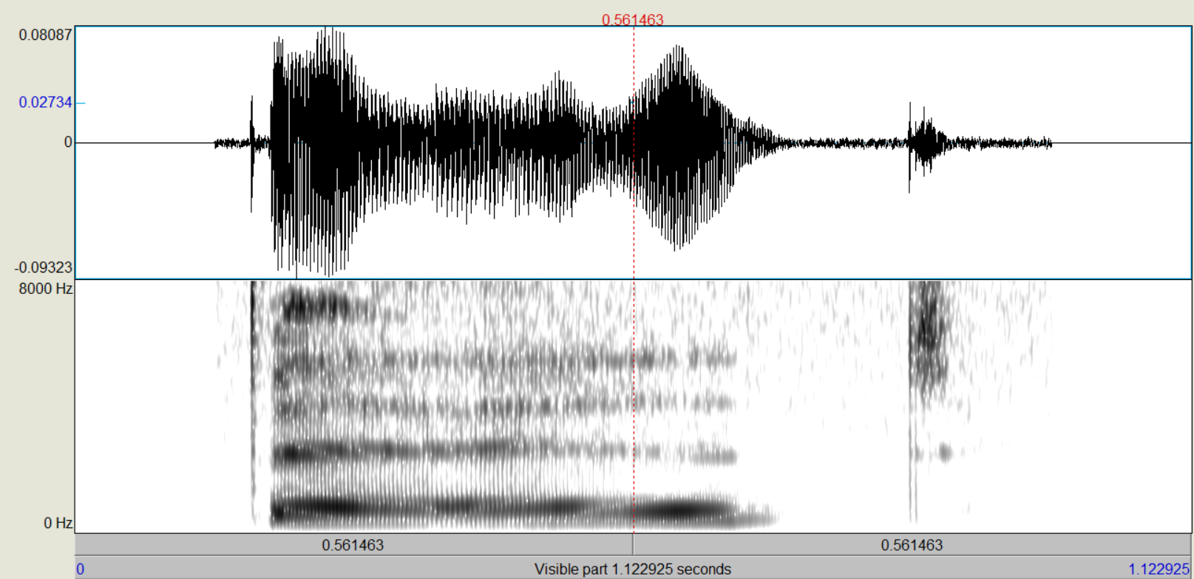
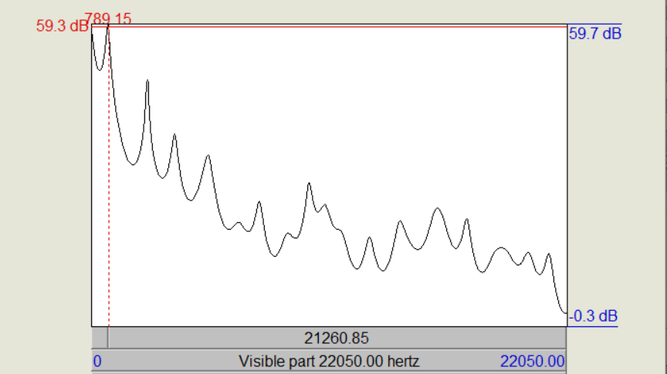
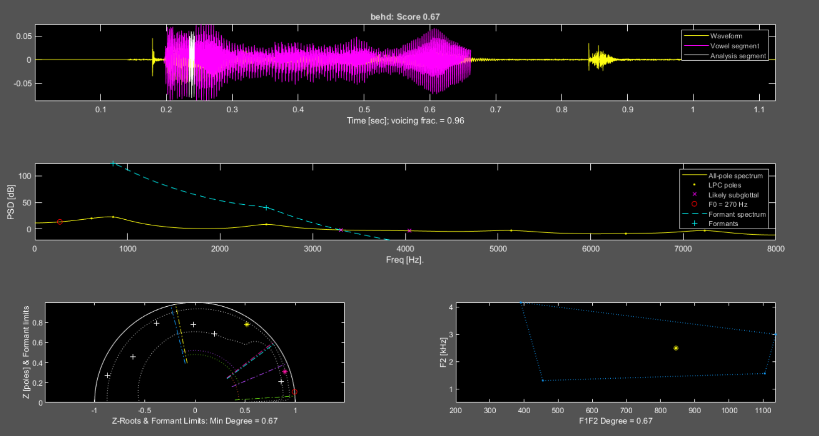
The Challenges and Uncertainties When Hand Measuring F1/F2 values in Child Speech: Towards an Automated Approach
Maame Agyarko, BS^{1,2}, Joel MacAuslan, PhD³, Marisha Speights Atkins¹, PhD, CCC-SLP
¹Northwestern University, ²University of Illinois Urbana Champaign, ³Speech Technologies & Applied Research Corp.
Background
Methods
Results: Hand vs. SpeechMark
Davis and MacNeilage commented over 30 years ago “Vowels are the poor relations of child phonology. There is perhaps less than one study of vowels for every 20 studies of consonants; and studies ostensibly dealing with a child’s complete vocal repertoire usually pay little attention to vowels” (1990, p.16).
Since that time, research reports devoted to vowels and vowel disorders continue to be few when compared to those on consonants (Kent & Rountrey, 2020).
Most of what we know about vowel development and disorders is derived from perceptual analysis, however the validity and reliability of the method has been questioned (Cox, 2008; Howard & Heselwood, 2013).
Acoustic methods are useful for studying speech development and disorders and for overcoming implicit biases intrinsic to perceptual phonetic transcription (Kent, 1996).
Formant frequencies are the most commonly used acoustic measurements for vowels, but procedures are not yet standardized to be used in general clinical populations (Kent & Vorperian, 2018) and more so for children.
A broad assumption is that phonetic mastery of vowels is accomplished early using perceptual methods, however acoustic studies show gradual mastery through 6 - 8 years (Kent & Rountrey, 2020).
A movement toward quantifiable acoustic measurement of vowels is needed for a comprehensive description of vowel development and disorders.
Speakers​
6 child speakers without speech disorders (age 4 years,1 month to 4 years,10 months)​
All speakers are native English speakers​
No history of hearing or speech disorders​
Recordings​​
Recordings were retrieved from the Speech Exemplars and Evaluation Database (Speights Atkins et al., 2020)​
Child recordings were made in a quiet room using portable handheld ZOOM H4N and H6N recorders equipped with XLR MOVO LV402 cardioid lavalier microphones.​
Speech samples were recorded at a 44.1 K sampling rate and 24-bit depth.
 |  | F1 |  | F2
/i/ | Hand | M = 491, SD =53.53 | t(3) = -1.08, p = 0.36 | M = 3657.2, SD = 368.20 | t(5) = 3.09, p = 0.02*
 | SM | M = 630, SD = 251.94 |  | M = 2651, SD = 560.03
/ɪ/ | Hand | M =612.43, SD = 112.99 | t(5) = -1.62, p = 0.16 | M =2751.14, SD = 472.07 | t(10) = 1.09, p = 0.29
 | SM | M = 796.79, SD =234.29 |  | M = 2491.87, SD = 349.21
/ɛ/ | Hand | M = 720.5, SD = 91.48 | t(8) = -1.48, p = 0.18 | M = 2307.17, SD = 408.58 | t(10) = 0.53, p =0.61
 | SM | M = 826.30, SD = 149.72 |  | M = 2187.41, SD = 374.66
/æ/ | Hand | M =982, SD = 361.50 | t(9) = -.23, p = 0.82 | M = 2578, SD = 429.65 | t(8) = 0.26, p = 0.80
 | SM | M =1026.62, SD = 290.51 |  | M = 2497.71, SD = 552.54
/u/ | Hand | M = 447.5, SD = 32.05 | t(5) = -0.72, p = 0.50 | M = 2645.17, SD = 253.14 | t(9) = -0.13, p = 0.90
 | SM | M = 532.09, SD =294.88 |  | M =2670.33, SD = 389.80
/o/ | Hand | M = 788.67, SD = 146.60 | t(9) = 1.26, p = 0.23 | M = 1996.5, SD = 194.42 | t(6) = -2.50, p = 0.05*
 | SM | M = 659.54, SD = 202.84 |  | M = 2885.82, SD = 850.13
/ʌ/ | Hand | M = 844.5 , SD = 215.43 | t(9) = 1.59, p = 0.15 | M = 1736.17, SD = 162.60 | t(6) = -1.23, p = 0.26
 | SM | M = 593.38, SD =322.42 |  | M = 1971.03, SD = 439.596 | t(6) = -1.23, p = 0.26
/ɑ/ | Hand | M = 999.67, SD = 135.29 | t(6) = 2.90, p =0.03* | M = 1665.5, SD = 160.45 | t(3) = -0.70, p = 0.53
 | SM | M = 710.38, SD = 165.85 |  | M = 2068.82 SD = 1142.20
Speech Material​
8 vowel were used in the analysis:​
​
/i/, /ɪ/, /ɛ/, /æ/ /ʌ/, /u/, /o/, /ɑ/ ​
​
Examples​
Teeth ,Pig ,Bed ,Van ,Duck, Shoe, Yoyo, Watch​
​
6 word were included in each vowel category​
​ 48 words (43 mono- & 5 multi-syllabic) ​
Measurements​
Mean F1/F2 hand measures by 2 analyst for each vowel using Wavesurfer, Praat
Mean F1/F2 Automated Vowel Analysis by SpeechMark (v. 2.0-beta)
Results: Linear Predictive Coding (LPC) Model for One Sample
Conclusions
Linear prediction (LP) is one of the most important tools in speech analysis.
LPC is based on a mathematical approximation of the vocal tract.
LP analysis decomposes the speech into two highly independent components, the vocal tract parameters (LP coefficients) and the glottal excitation (LP residual).
LPC analyzes the speech signal to estimate the formants
Hand and SpeechMark agreement for F1 was 88% and for F2 was 75%. When observing SpeechMark’s F3 for /i/, it was noted that it was a good fit for F2 .When manually adjusted, detection accuracy was increased to 88% for both F1 and F2.
Although students may enter the process of measuring F1/F2 values with a degree of uncertainty, they are able to learn to use a variety of tools and measure F1/F2.
This preliminary data supports previous findings that children with typically developing speech produce vowels within published F1/F2 ranges, however more studies are need to understand the variability within the population.
These preliminary findings support ongoing investigation of vowel measures in preschool age children using this standardized automated approach.
Purpose
In a step toward standardizing formant frequency measurement for our child vowel productions studies we present:
Measured F1/F2 formant frequencies using three different automated tools (Wavesurfer, Praat, & SpeechMark).
Comparisons of mean F1/F2 values obtained by a trained undergraduate researcher and an experienced research mentor.
The SpeechMark® Matlab toolbox, based on several published studies (e.g., Stevens, 1998; Lulich et al., 2011; Vorperian & Kent, 2007; McGowan et al.2014; Kent & Vorperian, 2018, Yeung et al., 2018) as an automated method for obtaining F1/F2 values.
Comparisons of hand measured and SpeechMark detected mean F1/F2 values.
Top: Waveform, SpeechMark syllabic segment, and small window about vowel-LM within segment.
Mid: LPC spectrum and poles (solid, .) ; F0 (red circle); formant spectrum and identified formants (dashed, +); likely subglottal resonances (x).
LL: Z-plane of unit circle (solid); positions of poles (+); formants and frequency boundaries (color); bandwidth boundaries (dotted).
LR: Location of identified (F1,F2) (*); fiducial boundaries of a conventional (F1,F2) quadrilateral (dotted).
Maame’s SURIEA Experience
Before joining the SURIEA program I didn't know a lot about acoustics.
The SURIEA program helped me grow my foundation of acoustics across a wide range of fields. and I believe that this information would be beneficial for me as I enter my future career.
One Ah-ha moment that I had during this program was when I was able to finally finish my presentation, It was surreal to me because this is my first research project. I was proud because even though I had a lot of imposter syndrome. I was able to overcome that challenge.
Research questions
Is there a difference between the mean F1 & F2 values when measured by two different analysts?
H₀: There is no mean difference between analysts.
Is there a difference between hand and automated measurement of the mean F1 & F2 values?
H₀: There is no mean difference between hand and automated measurement.
Results: Hand Measurement Comparison of Means
Vowel | Analyst | n | Mean | SD | t-cal | t-crit | df | p | Decision |  | Mean | SD | t-cal | t-crit | df | p | Decision
F1 |  |  |  | F1 |  |  |  |  |  |  | F2 |  | F2
/i/ | 1 | 6 | 433.5 | 102.57 | -1.24 | 2.36 | 7 | 0.25 | Do not reject |  | 2640.5 | 51.385 | -0.9175 | 2.22814 | 10 | 0.38 | Do not reject
 | 2 |  | 491 | 47.94 |  |  |  |  |  |  | 3240.67 | 56.927
/ɪ/ | 1 | 6 | 577.333 | 138.327 | -0.7849 | 2.262157 | 9 | 0.45 | Do not reject |  | 2006 | 919.22 | -1.6196 | 2.306 | 8 | 0.14 | Do not reject
 | 2 |  | 633.5 | 107.664 |  |  |  |  |  |  | 2695 | 490.86
/ɛ/ | 1 | 6 | 902.667 | 274.817 | 1.54057 | 2.446912 | 6 | 0.08 | Do not reject |  | 2012.83 | 739.15 | -0.8537 | 2.306 | 8 | 0.41* | Do not reject
 | 2 |  | 720.5 | 91.481 |  |  |  |  |  |  | 2307.16 | 408.57
/æ/ | 1 | 6 | 902.667 | 274.817 | -0.428 | 2.262157 | 9 | 0.68 | Do not reject |  | 1624.67 | 669.59 | -2.9352 | 2.26216 | 9 | 0.02* | Reject
 | 2 |  | 982 | 361.504 |  |  |  |  |  |  | 2578 | 429.65
/u/ | 1 | 6 | 490.667 | 59.1698 | -0.3463 | 2.228139 | 10 | 0.73 | Do not reject |  | 1710.5 | 819.47 | -0.2594 | 2.22814 | 10 | 0.8 | Do not reject
 | 2 |  | 502.167 | 55.8155 |  |  |  |  |  |  | 1825.33 | 709.89
/o/ | 1 |  | 844.833 | 110.09 | 2.26607 | 2.228139 | 10 | 0.05* | Reject |  | 1639.67 | 284.437 | -0.6958 | 2.26216 | 9 | 0.5 | Do not reject
 | 2 | 6 | 692.667 | 122.209 |  |  |  |  |  |  | 1784.67 | 423.86
/ʌ/ | 1 |  | 773.667 | 156.75 | -0.6512 | 2.262157 | 9 | 0.53 | Do not reject |  | 1403.33 | 358.95 | -2.0689 | 2.36462 | 7 | 0.07 | Do not reject
 | 2 |  | 844.5 | 215.431 |  |  |  |  |  |  | 1736.17 | 162.59
/ɑ/ | 1 | 6 | 1060.67 | 49.314 | 1.03765 | 2.446912 | 6 | 0.33943 | Do not reject |  | 1775 | 114.04 | 1.36259 | 2.26216 | 9 | 0.2061 | Do not reject
 | 2 |  | 999.667 | 138.327 |  |  |  |  |  |  | 1665.5 | 160.449
References
Cox, F. (2008). Vowel transcription systems: An Australian perspective. International Journal of Speech-Language Pathology, 10(5), 327-333.
Davis, B. L., & MacNeilage, P. F. (1990). Acquisition of correct vowel production: A quantitative case study. JSLHR, 33(1), 16-27.
Howard, S. J. , & Heselwood, B. (2013). The contribution of phonetics to the study of vowel development and disorders. In Ball M. & Gibbon F. (Eds.), Vowel disorders (pp. 79–130). Butterworth–Heinemann
Kent, R. D. (1996). Hearing and believing: Some limits to the auditory-perceptual assessment of speech and voice disorders. American Journal of Speech-Language Pathology, 5(3), 7-23.
Kent, R. D., & Rountrey, C. (2020). What acoustic studies tell us about vowels in developing and disordered speech. American Journal of Speech-Language Pathology, 29(3), 1749-1778.
Kent, R. D., & Vorperian, H. K. (2018). Static measurements of vowel formant frequencies and bandwidths: A review. Journal of Communication Disorders, 74, 74-97.
Lulich, S. M. (2010). Subglottal resonances and distinctive features. Journal of Phonetics, 38(1), 20-32.
McGowan, R. W., McGowan, R. S., Denny, M., & Nittrouer, S. (2014). A longitudinal study of very young children's vowel production, Journal of Speech, Language, and Hearing Research, 57(1),1-15
Stevens, K. N. (1998). Acoustic phonetics (Vol. 30). MIT press.
Speights Atkins, M., Bailey, D. J., & Boyce, S. E. (2020). Speech exemplar and evaluation database (SEED) for clinical training in articulatory phonetics and speech science. Clinical linguistics & phonetics, 34(9), 878-886.
Vorperian, H. K., & Kent, R. D. (2007). Vowel acoustic space development in children: A synthesis of acoustic and anatomic data, Journal of Speech, Language, and Hearing Research, 50(6),1510-1545.
Yeung, G., Lulich, S. M., Guo, J., Sommers, M. S., & Alwan, A. (2018). Subglottal resonances of American English speaking children. The Journal of the Acoustical Society of America, 144(6), 3437-3449.
Acknowledgements
This work was supported by grants from NIH, especially R44DC010104 (SpeechMark), Auburn U. OVPRED Innovation Award & Daniel F. Breeden Endowed Grant.
Acoustical Society of America SURIEA Program.
For more information send e-mail to: marisha.speights@northwestrn.edu

